Slide 1
Motivation

Slide 2
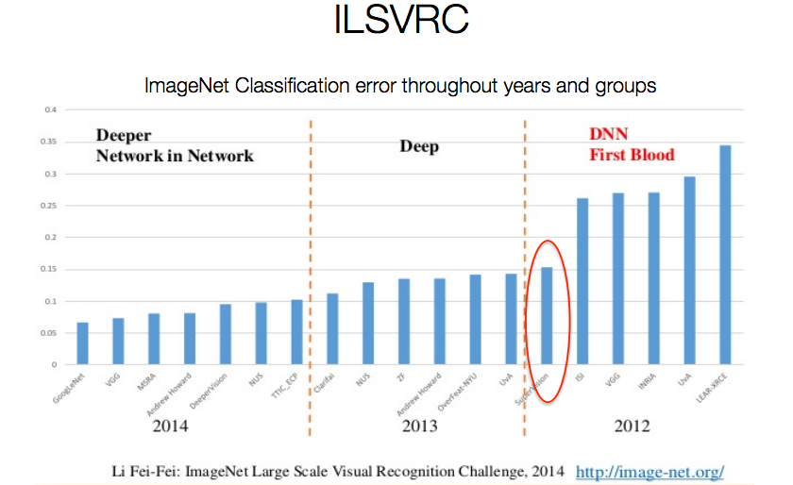
ImageNet Challenges

Slide 3
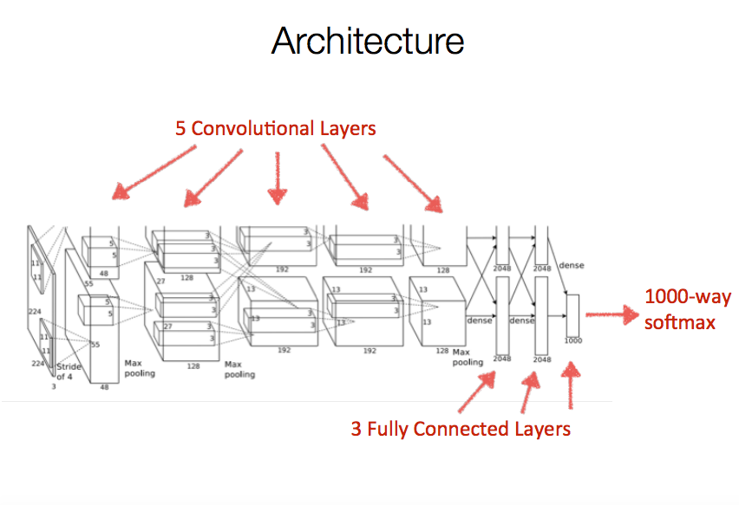
Image Classification Using Deep Convolutional Neural Network

Slide 4
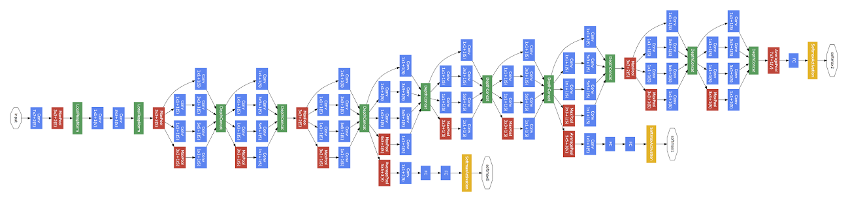
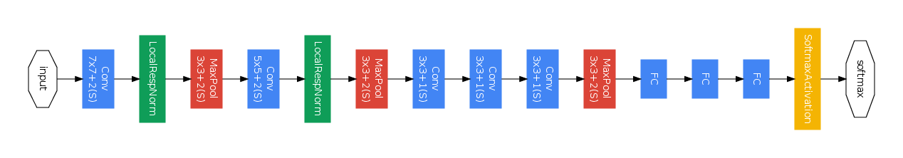
GoogLeNet
GoogLeNet
Convolution
Pooling
Softmax
Other
Zeiler-Fergus Architecture (1 tower)

Slide 5
Very Deep Convolutional Network for Image scaling

Slide 6
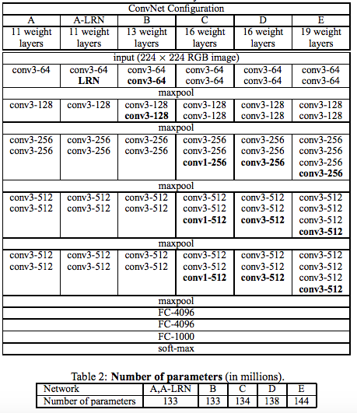

Slide 7
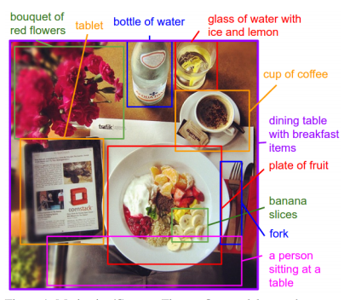
Image Captioning

Slide 8
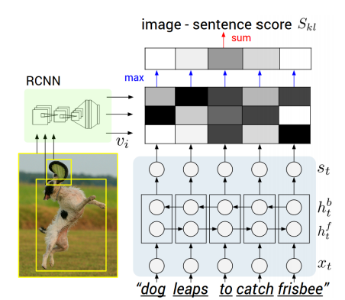
Deep Visual Semantic alignments for generating image description

Slide 9
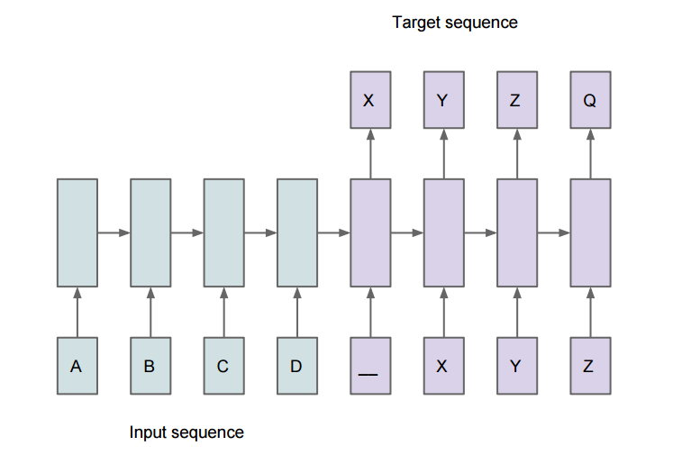
Sequence to Sequence Learning with Neural Net

Slide 10
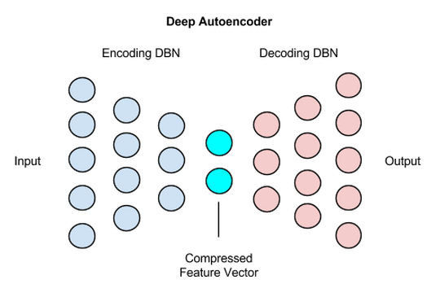
Autoencoders

Slide 11
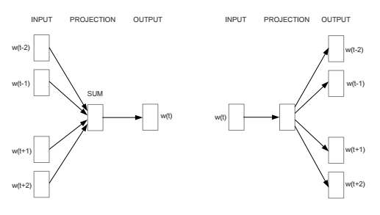
Words embedding (word2vec)

Slide 12
Difficulties in training Neural Networks
Objective function non-convex, can get trapped in local minima, often leads to under fitting.
Large number of hyper parameters involved
Vanishing gradient problem while back propagating errors
SGD more practical, but difficult to parallelize

Slide 13
Related Work
Hinton et al.(2006) – proposed the idea of layer wise pre training.
Greedy layer wise pre training one layer at a time.
Pre training is unsupervised (better abstraction of features).
Helps in setting the weight parameter in a relatively better region (close to a good local minima).
Later, fine tune the parameters by a practical optimization approach like SGD.

Slide 14
Related Work (continued….)
Martens (2010)- came up with Hessian free optimization for deep learning.
second order optimization technique without pertaining, quadratic objective, no Hessian approximation.
uses semi online approach, in the form of mini batch.
Uses pathological curvature information, more distance travelled along low curvature directions. (in accordance with Newton’s method).
Efficient computation of matrix and vector product using finite differences, linear conjugate gradient method used.

Slide 15
Related Work (continued….)
Sutskevar et al.(2013)- implemented momentum based SGD on autoencoders, got performance as good as HF method by Martens.
Compared Classical momentum and Nesterov’s accelerated momentum with SGD for deep learning (autoencoders), later performed better.
Instead of Random initialization, used Sparse initialization.(used in HF by Martens)
Proper momentum schedule was used, higher momentum constant achieved better performance.

Slide 16
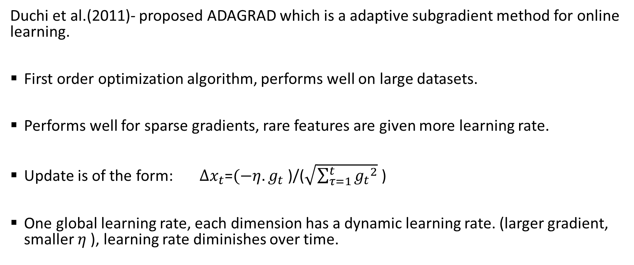
Related Work (continued….)
Duchi et al.(2011)- proposed ADAGRAD which is a adaptive subgradient method for online learning.
First order optimization algorithm, performs well on large datasets.
Performs well for sparse gradients, rare features are given more learning rate.
Update is of the form: $∆x_{t}$=$(−η.g_{t}$ )/($\sqrt{\sum_{τ=1}^{t}{{g_{t}}^{2}}}$ )
One global learning rate, each dimension has a dynamic learning rate. (larger gradient, smaller $η$ ), learning rate diminishes over time.

Slide 17
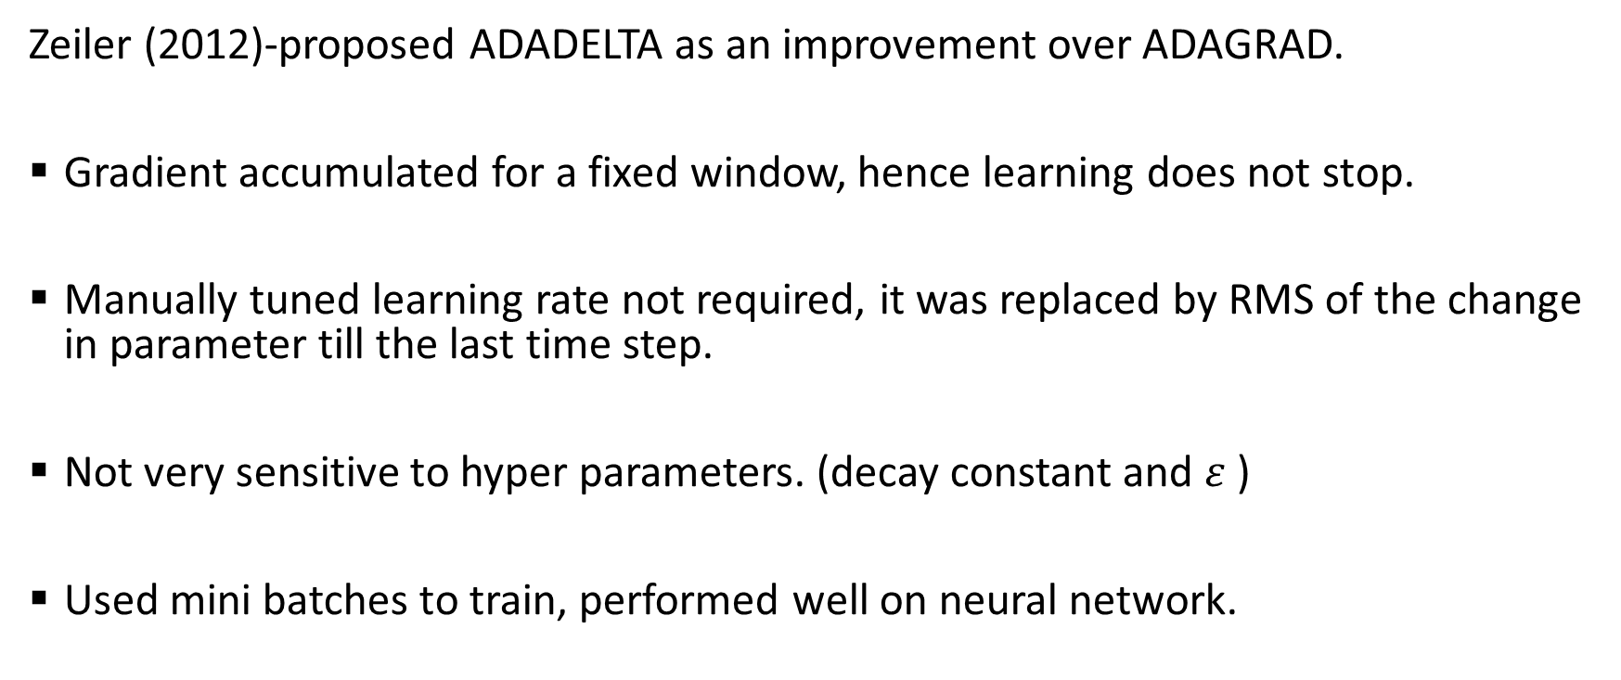
Related Work (continued….)
Zeiler (2012)-proposed ADADELTA as an improvement over ADAGRAD.
Gradient accumulated for a fixed window, hence learning does not stop.
Manually tuned learning rate not required, it was replaced by RMS of the change in parameter till the last time step.
Not very sensitive to hyper parameters. (decay constant and $ε$ )
Used mini batches to train, performed well on neural network.

Slide 18
Related Work (continued….)
Kingma et al.(2015)-proposed ADAM, which is a SGD method based on first and second order moment estimates.
Combines advantages of ADAGRAD( sparse gradients) and Rmsprop(non-stationary objective).
Updates a moving average of first moment (mean of gradient) and second moment at every iteration.(variance of gradient)
Corrects the biased moment estimates. Bias due to initialization of the moment estimates to 0.

Slide 19
Project proposal
Implementing the algorithms discussed in the related work section for deep learning.
Try understanding how these work in simple neural network (multi layer neural network) and then extend it to autoencoders and deep convolutional network. (if time permits!!)
Try to understand the strength and flaws of these algorithms, come up with some modification of these algorithms which works well. (hopefully!!)

Slide 20
Strategy
Implement on the publicly available MNIST and CIFAR-10 dataset.
Validate our results against Caffe solver.
Use the results published in these papers as baseline algorithms for comparing any new results.

Slide 21
Future Work
Interesting to see how the algorithms discussed would perform as experts on multi layer neural network.
Understanding the various intricacies of these algorithms in details and coming up with some algorithm which performs better (or atleast the same!!) in terms of accuracy and convergence. (already discussed)
The effect of regularization on these algorithms. (some insight into whether these algorithms overfit or not by introducing dropout, regularization, etc )

Slide 22
Future Work
Comparison between first and second order methods on multi layer neural network to evaluate the utility of curvature information in a stochastic or online setting.

Slide 23
Thank you!!!

